Slide 1
HW
Project
Week 1
HW
HW
HW
Project
HW
Midterm
HW
HW
Project
HW
HW
Midterm
HW
Project
HW
HW
Week 16
Final

Slide 2
Agile Classroom
Day of the Week | In Class | Group A | Group B
Wednesday | Guided Programming | Participate | Patriciate
Monday | Work on Sprint | Sprint reviews + Work on Sprint | Work on Sprint
Wednesday | Prof-led Programming | Participate | Participate
Monday | Guided Programming | Work on Sprint | Sprint Reviews + Work on Sprint

Slide 3
Sprint
Week 1
Sprint
Sprint
Sprint
Sprint
Sprint
Sprint
Week 16
Final Presentation

Slide 4
HW
Project
Week 1
HW
HW
HW
Project
HW
Midterm
HW
HW
Project
HW
HW
Midterm
HW
Project
HW
HW
Week 16
Final

Slide 5
An Agile, Sprint-based Class
©Me, meaning not you.
Not that anyone on the internet respects copyright…and I don’t really care that much. Unless you somehow make lots of money from these slides and an attorney convinces me that paying him lots of money will make me lots of money if I sue you. Then we’ll both be in trouble because you’ll be forced to spend lots of money on an attorney to keep yourself from paying even more money if you lose the suit. In short, we both lose big because we have to pay the attorneys. The attorneys win big because they win either way. I have nothing to lose because I don’t have to sue, and if I do, I’m taking a calculated risk—money down on an attorney as the ante on getting big bucks out of a law suit. You have everything to lose (attorney fees, and potentially the suit), but hardly anything to gain. I mean, are these slides really worth copying? Informative, maybe, but copying and using to make gobs of money? The take away? If you’re going to copy these slides, you had better not use them to make enough money that an attorney will hunt me down and convince me that it’s worth paying him/her to sue you. Enough said?

Slide 6
Traditional Class
HW
Project
Week 1
HW
HW
HW
Project
HW
Midterm
HW
HW
Project
HW
HW
Midterm
HW
Project
HW
HW
Week 16
Final

Slide 7
Agile Class
Course Intro
Week 1
Sprint
Sprint
Sprint
Sprint
Sprint
Sprint
Week 16
Final Presentation

Slide 8
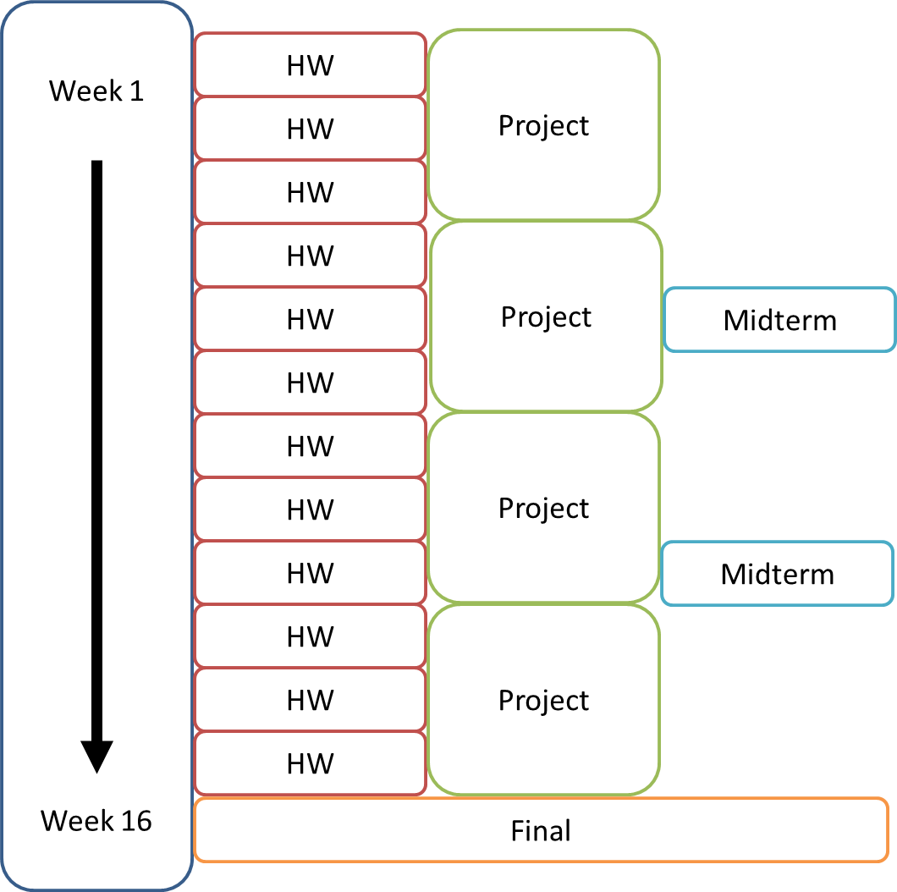
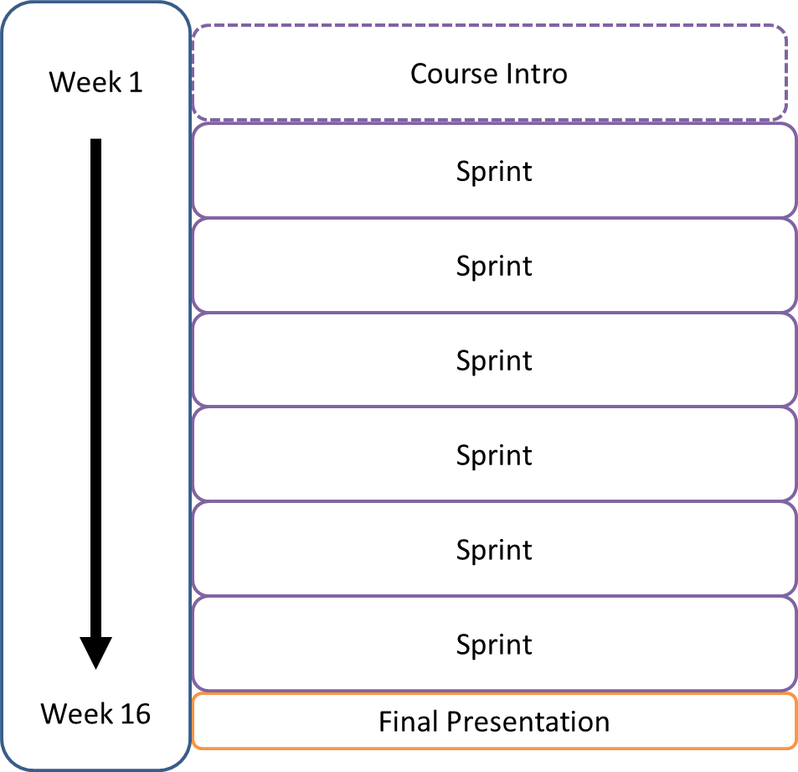
Comparison

Slide 9
What a sprint will look like to you
In Class
At Home
Sprint
Week
Guided Programming
Hours and Hours Working on the Sprint
Week
Work on Sprint + Get Help
Guided Programming
Week
Sprint Review + Work on Sprint

Slide 10
Two groups in class
Week
Sprint Group A
Week
Sprint Group B
Week
Week

Slide 11
What can I work on during a Sprint?
It’s up to you, as long as…
It’s relevant to the class
Covers the core pillars
Isn’t another assignment/work/project

Slide 12
How are sprints graded?
Preparation
Do you have something to show?
Self assessment.
Did I spend hours and hours outside of class working on this sprint?
My assessment.
You can communicate fluently about the project.
You are participating in class.
What you achieved in your sprint.

Slide 13
Things to remember
W = Instruction
M = Work on Sprint
3 Absences and you’re dropped.
Relax.

